Slide 1
CS181: Principles of
Machine Learning and AI
Spring 2024
David Alvarez-Melis and Finale Doshi-Velez
Harvard Computer Science
Staff: Alex Cai, Charumathi Badrinath (head TFs), Angela Li, Brian Ham, Audrey Chang, Ahmad Abdel-Azim, Gabriel Sun, Shirley Zhu, Jeffrey Xu, Alyssa Huang, Derek Zheng, Sam Jones, Neeyanth Kopparapu, Andrew Zhao, Joshua Park
Notes:
1
introductions

Slide 2
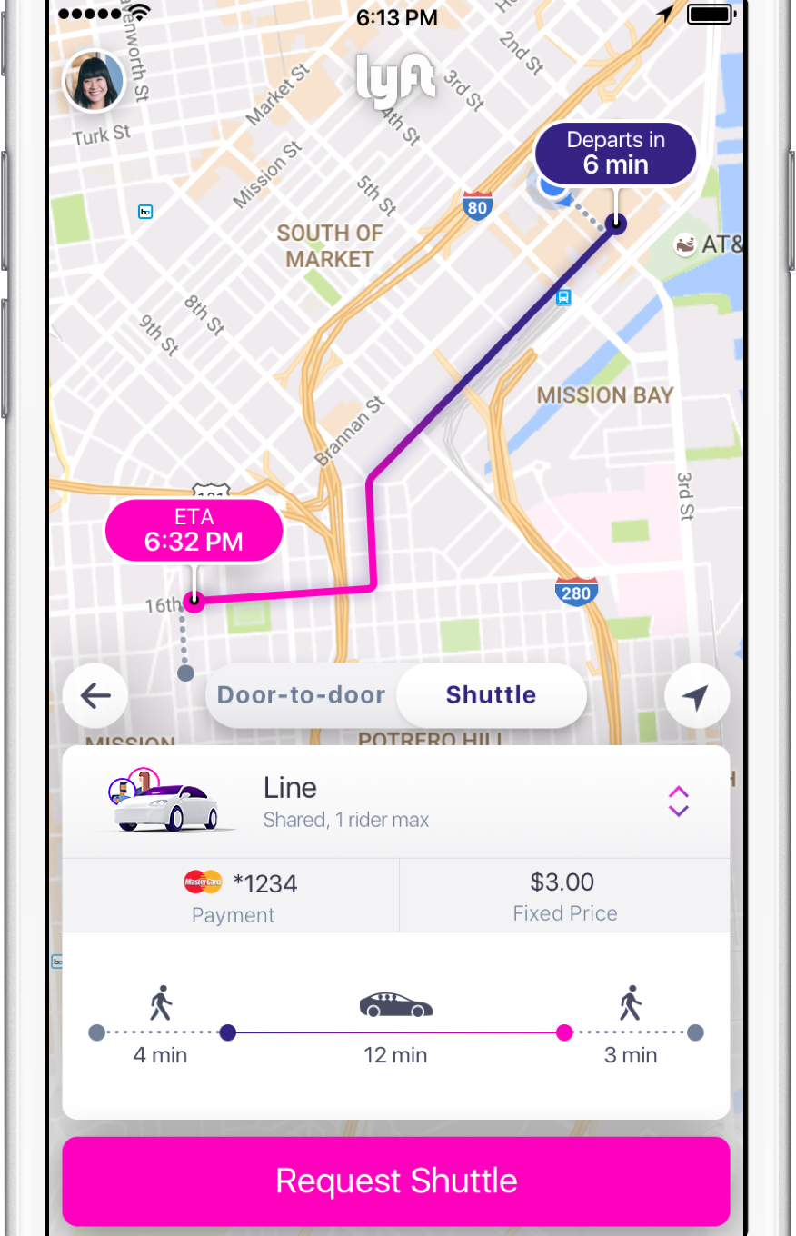
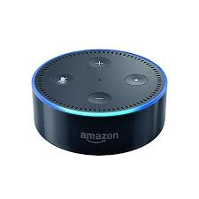
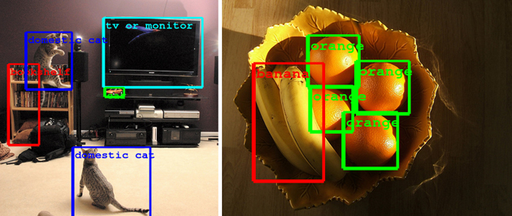

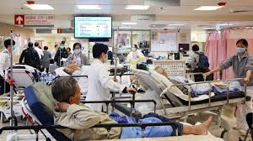

What this course is about
https://s.aolcdn.com/hss/storage/midas/cb433fb6c234b014394ad56714ceee8b/200707597/google-image-recognition-tech.jpg
https://cdn.shopify.com/s/files/1/0684/3445/products/Partner_AmazonEcho_small_031932b3-c31d-4977-a922-5ebbe052bad6.jpg?v=1497504913
https://cdn.lyft.com/brochure/shuttle-screenshot.1e79cd66.png
https://cdn3.i-scmp.com/sites/default/files/styles/980x551/public/images/methode/2016/05/29/b0dc6826-2577-11e6-80b1-a87df553e801_1280x720.JPG?itok=QVZxRMvy
Notes:
2

Slide 3
What this course is about
We can build the most amazing things!
https://s.aolcdn.com/hss/storage/midas/cb433fb6c234b014394ad56714ceee8b/200707597/google-image-recognition-tech.jpg
https://cdn.shopify.com/s/files/1/0684/3445/products/Partner_AmazonEcho_small_031932b3-c31d-4977-a922-5ebbe052bad6.jpg?v=1497504913
https://cdn.lyft.com/brochure/shuttle-screenshot.1e79cd66.png
https://cdn3.i-scmp.com/sites/default/files/styles/980x551/public/images/methode/2016/05/29/b0dc6826-2577-11e6-80b1-a87df553e801_1280x720.JPG?itok=QVZxRMvy
Notes:
3

Slide 4

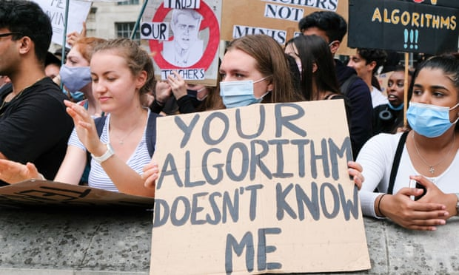
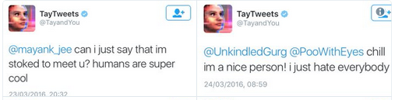
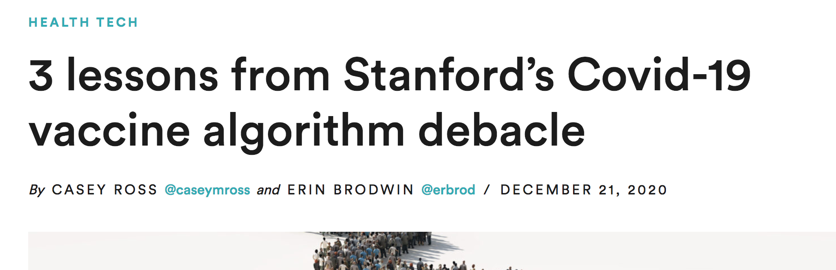
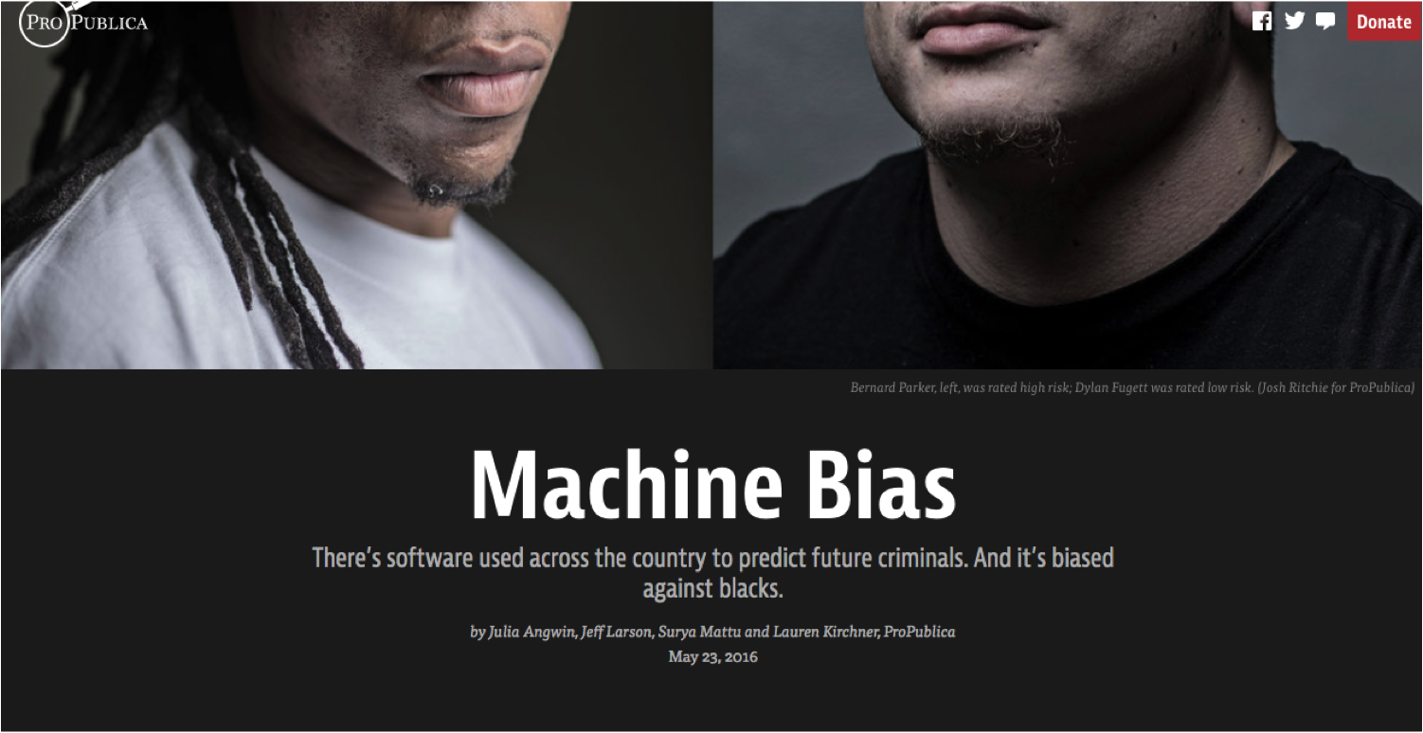
What this course is about
https://twitter.com/geraldmellor/status/712880710328139776 https://www.statnews.com/2020/12/21/stanford-covid19-vaccine-algorithm/ https://www.theguardian.com/education/2020/aug/20/england-exams-row-timeline-was-ofqual-warned-of-algorithm-bias https://www.propublica.org/article/machine-bias-risk-assessments-in-criminal-sentencing https://www.reuters.com/article/us-amazon-com-jobs-automation-insight/amazon-scraps-secret-ai-recruiting-tool-that-showed-bias-against-women-idUSKCN1MK08G
Notes:
4
https://www.statnews.com/2020/12/21/stanford-covid19-vaccine-algorithm/ https://en.wikipedia.org/wiki/Tay_(bot)#:~:text=Tay%20was%20an%20artificial%20intelligence,service%20only%2016%20hours%20after. "Tay" went from "humans are super cool" to not n <24 hrs https://www.theguardian.com/education/2020/aug/20/england-exams-row-timeline-was-ofqual-warned-of-algorithm-bias

Slide 5
What this course is about
Rigor, professionalism,
ethics, and inclusion are all essential!
https://twitter.com/geraldmellor/status/712880710328139776 https://www.statnews.com/2020/12/21/stanford-covid19-vaccine-algorithm/ https://www.theguardian.com/education/2020/aug/20/england-exams-row-timeline-was-ofqual-warned-of-algorithm-bias https://www.propublica.org/article/machine-bias-risk-assessments-in-criminal-sentencing https://www.reuters.com/article/us-amazon-com-jobs-automation-insight/amazon-scraps-secret-ai-recruiting-tool-that-showed-bias-against-women-idUSKCN1MK08G
Notes:
5
https://www.statnews.com/2020/12/21/stanford-covid19-vaccine-algorithm/ https://en.wikipedia.org/wiki/Tay_(bot)#:~:text=Tay%20was%20an%20artificial%20intelligence,service%20only%2016%20hours%20after. "Tay" went from "humans are super cool" to not n <24 hrs https://www.theguardian.com/education/2020/aug/20/england-exams-row-timeline-was-ofqual-warned-of-algorithm-bias

Slide 6
What happens after CS 181?

Slide 7



ML 101 in a nutshell
Given: task description, data, model class, loss objective
data
model class
trained model
train
test

Slide 8





The Bad News
Given: task description, data, model class, loss objective
training data sources
pre-trained model
fine-tuning data
data
model class
trained model
Task: ?? , Loss: ??
train
model classes
target task data
trained model
test
Machine Learning Courses
Machine Learning in the ‘wild’

Slide 9

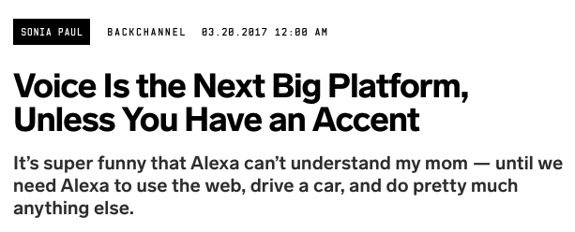


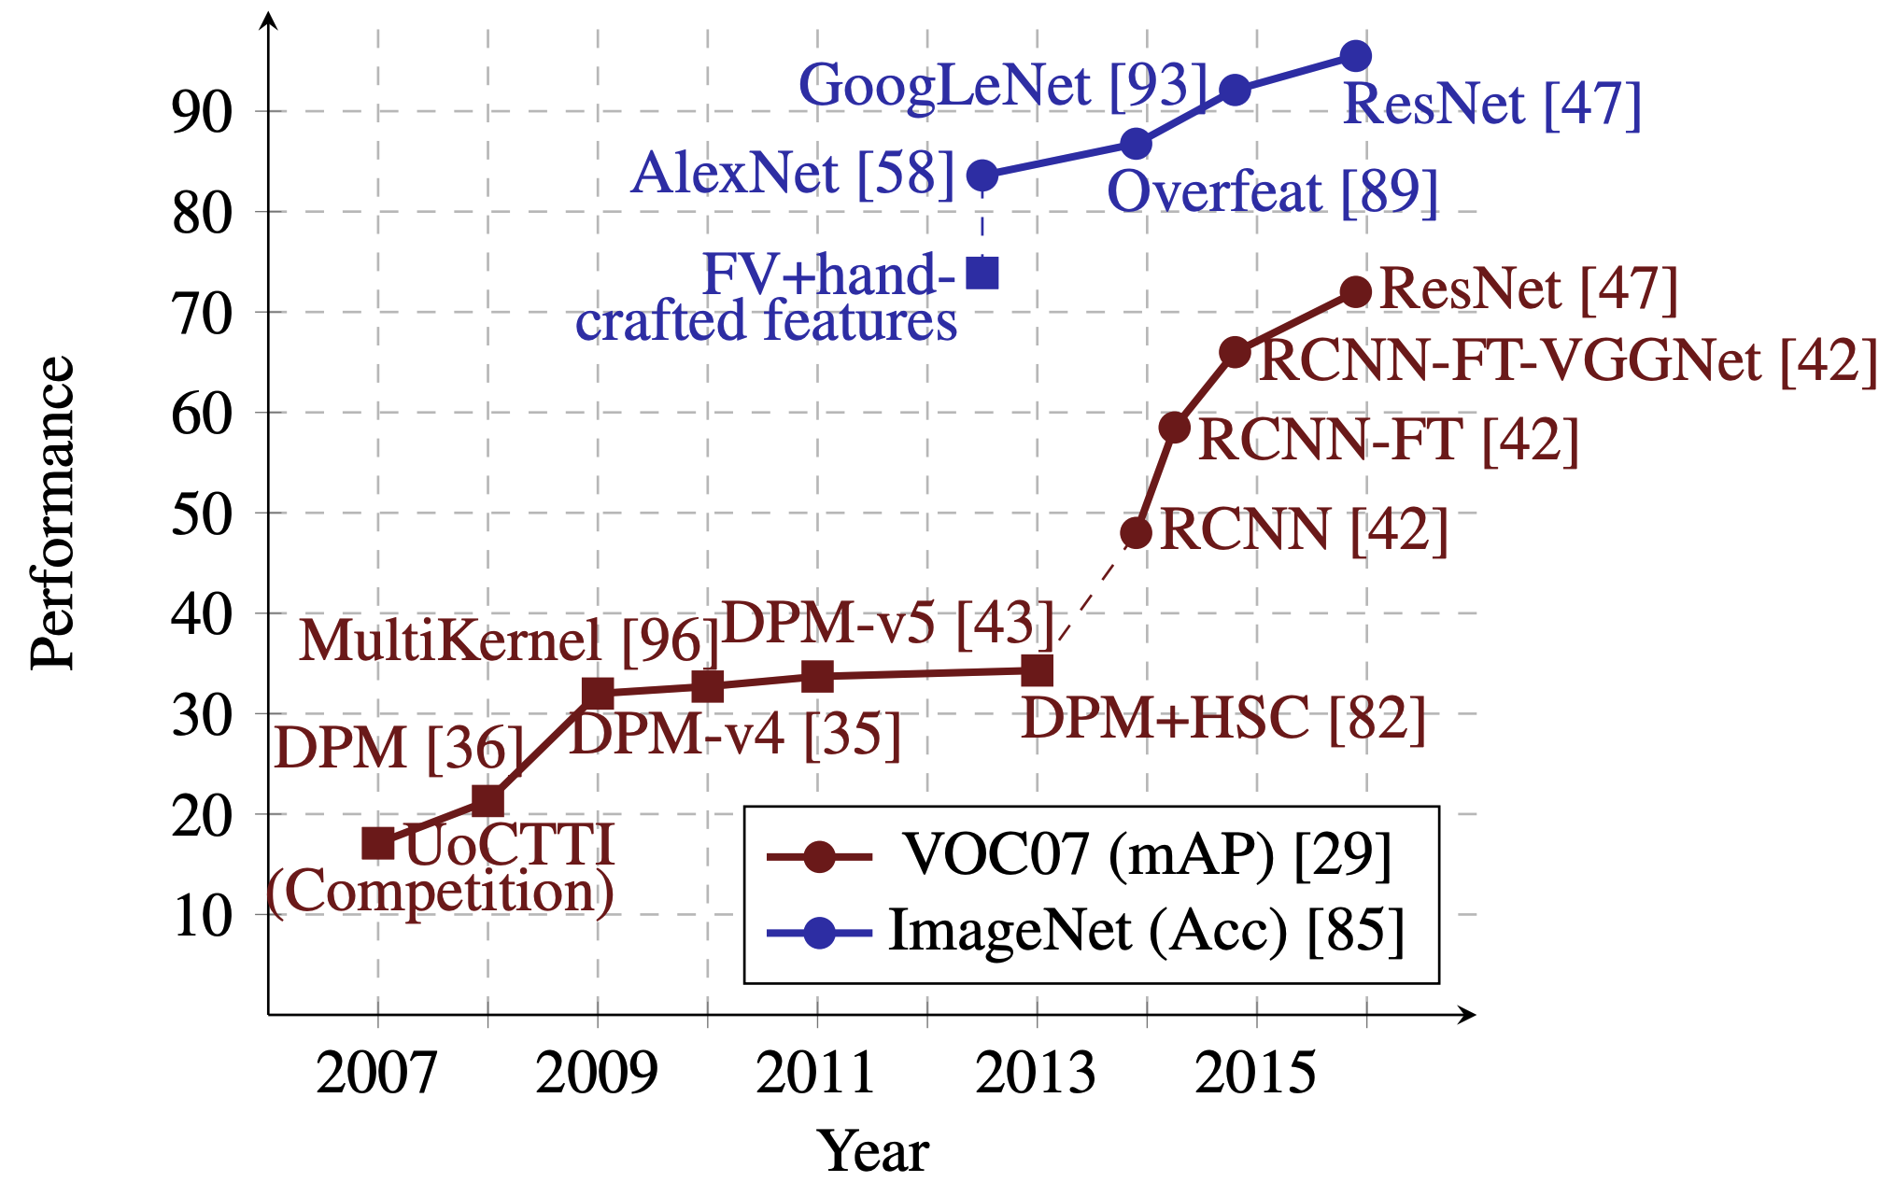
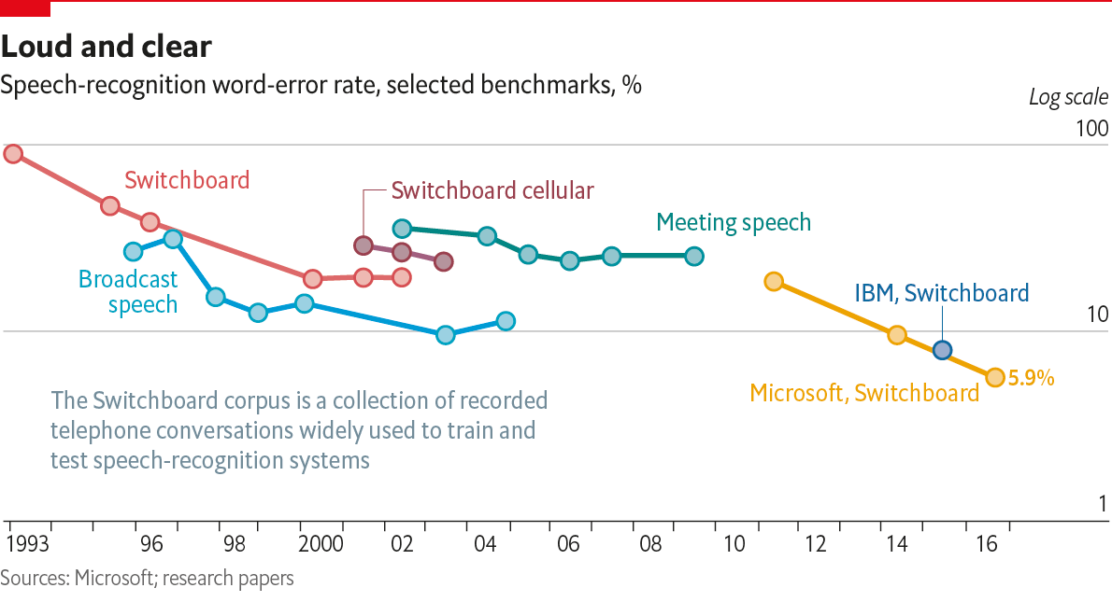

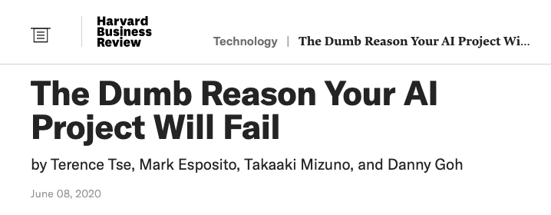

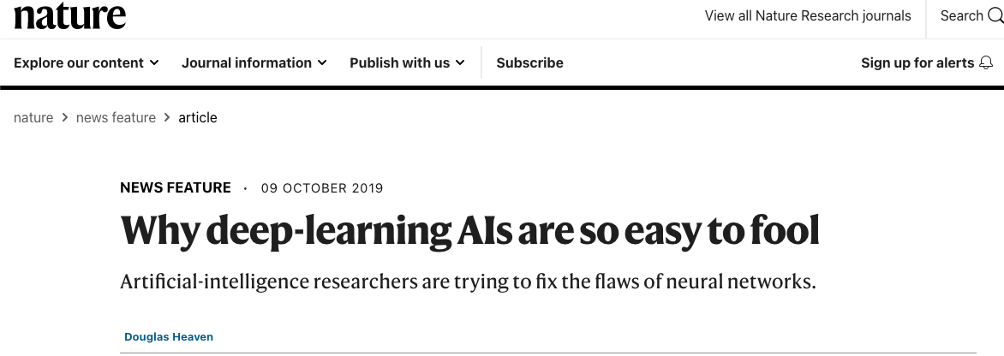

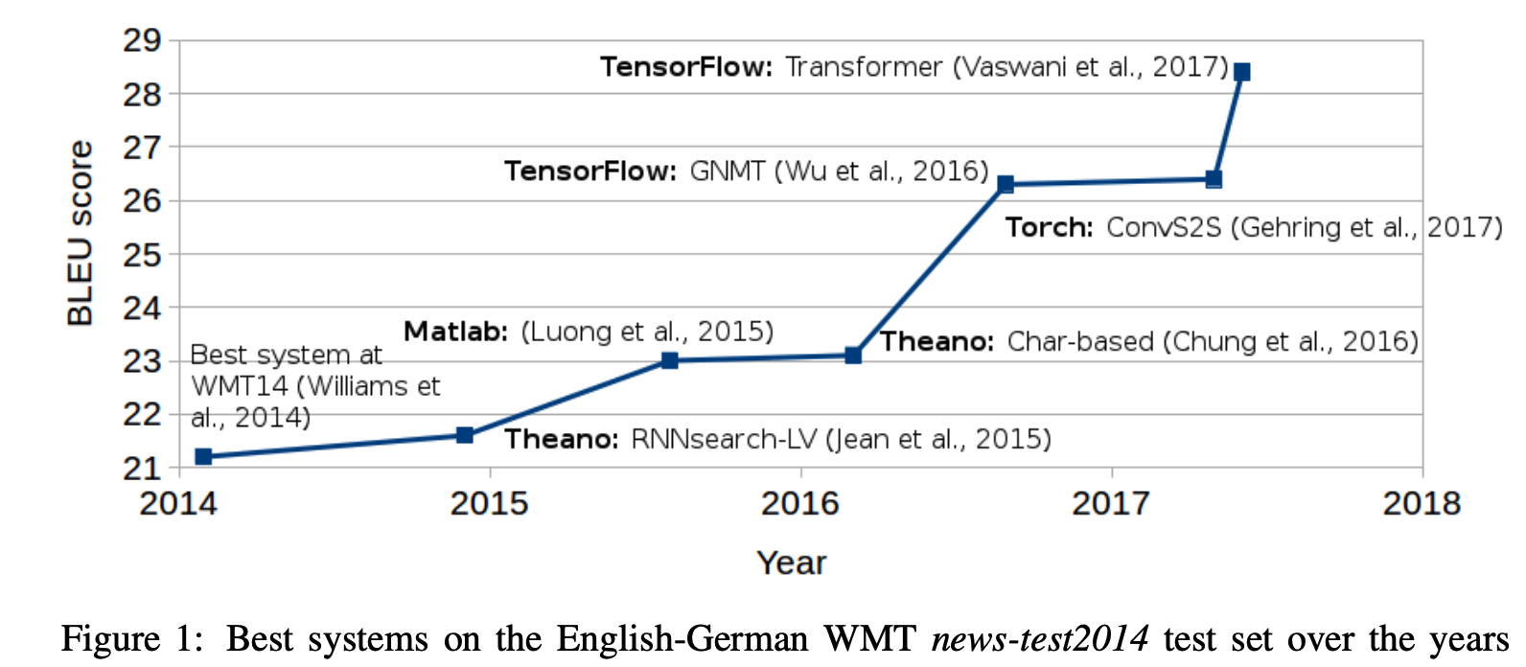

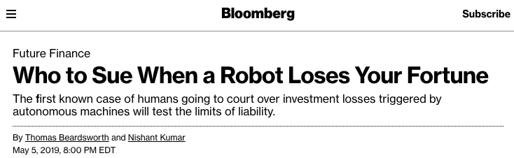
A Tale of Two Fields
Image Classification
Speech Recognition
Credit: [Sharif Razavian, 2017]
Credit: The Economist
Machine Translation
Credit: [Stahlberg et al., 2018]
‘Benchmark’ Machine Learning
Machine Learning in the ‘wild’

Slide 10
The Good News
The same fundamental principles we will learn in this class can be re-used and extended to tackle ”ML in the Wild” too:
e.g. probabilistic modeling, generalization, bias-variance tradeoffs, representation, capacity, overfitting, etc
‘Benchmark’ Machine Learning
Machine Learning in the ‘wild’

Slide 11
My group’s research
Bridging the gap between 'textbook ML’ and ‘real ML’ requires* new methods & theory for:
manipulating multiple heterogeneous noisy data sources
understanding model (and data) failures
*among many other things
‘Benchmark’ Machine Learning
Machine Learning in the ‘wild’

Slide 12
Data-Centric ML: Better datasets for better (reliable & trustworthy) models
Data “Learning”
How can we (mathematically) optimize the training data we feed intro our models?
Model ↔ Data Interpretability
What can we learn about the inner workings of a model through the lens of how it processes data?
ML with Structured Data
How should we deal with data with rich geometric structure (e.g., Molecules, DNA sequences, graphs) ?

Slide 13

Data learning: Adapting models by adapting datasets
Work partly done while at Microsoft Research in collaboration with:
Jiaojiao Fan, Nicolò Fusi, Jimmy Hall, Lester Mackey, Neil Tenenholtz

Slide 14


What does adaptation mean in the era of large pretrained models?

Slide 15





Model-Centric
A new data-centric learning paradigm
Data-Centric
Data
Model
Data
Model
Fixed
Optimized
Optimized
Fixed/Optimized
A new class of optimization problems:
a dataset is the optimization variable
objective defined on entire datasets
Theoretical backbone: Optimal Transport
$$ℒ\left({ \atop }\right)$$
We are envisioning a new class of optimization problems, where the dataset is the optimization variable, and the optimization objective pertains to the dataset itself.
$$\min{}$$

Slide 16


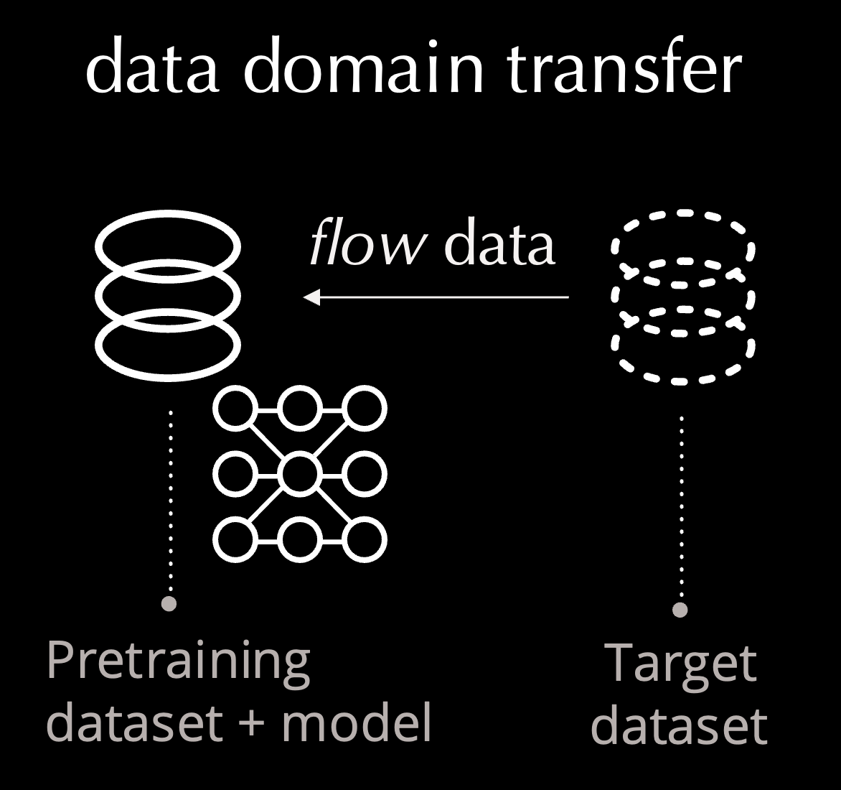





Data Learning Tasks

Slide 17


How are large pre-trained models used in practice?
Status-quo: adapt model, data is fixed
Predict
This is often inefficient or altogether impossible
(e.g., LLM via API access)
Train
Fine-Tune
pre-trained model
(on general-purpose data)
fine-tuned model
(on limited specialized data)
Source Domain
Target Domain

Slide 18
Large model adaptation doesn’t scale well
adapt
adapt
adapt
Target Domains
(e.g. customers)
adapt
Source Domain
(e.g. AI provider)
adapt

Slide 19
Efficient adaptation by modifying data
Model-centric: adapt model, data is fixed
Predict
Fine-Tune
Predict
Data-Centric: adapt data, model is fixed
Adapting the data allows us to impose additional constraints (privacy / size / etc.)!
Pre-Training Domain
(general-purpose data)
Target Domain
(limited specialized data)

Slide 20



Our Main Tool: Optimal Transport
A sub-field at the intersection of optimization, statistics and geometry.
Centuries worth of theory: Monge (1780s), Kantorovich (1940s), Villani, Figalli, etc.
Fast algorithms (~2014 – now).
Compare
Match
Transform
$$d(P_{A},P_{B})$$
$$π(x_{i},y_{j})$$
T$\left(x_{i}\right)≈y_{j}$

Slide 21


Transforming Datasets via Gradient Flows
Distance* to target dataset
gradient flow using optimal transport
Initial dataset + objective + constraints ⟶ Learned dataset
e.g. pretraining data
Size? Privacy? Invariances?
*Optimal Transport Dataset Distance (OTDD) [NeurIPS 2020]
[A-M & Fusi, ICML 2021]

Slide 22
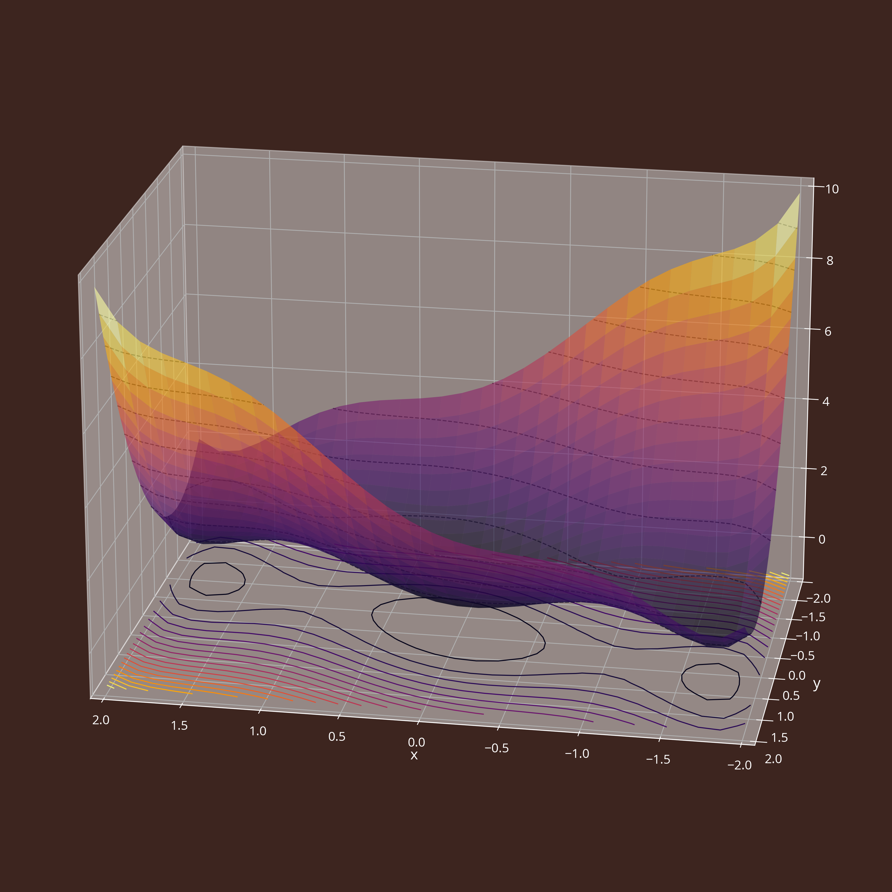
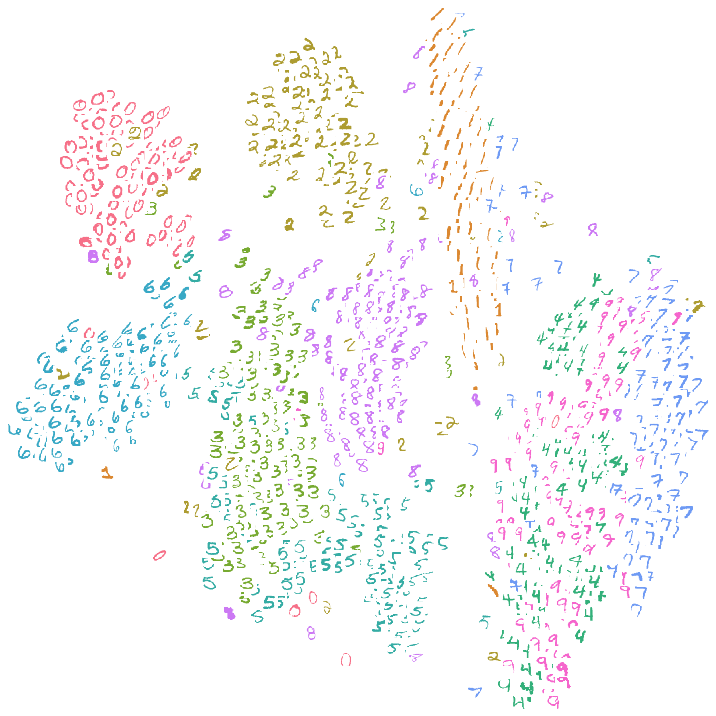
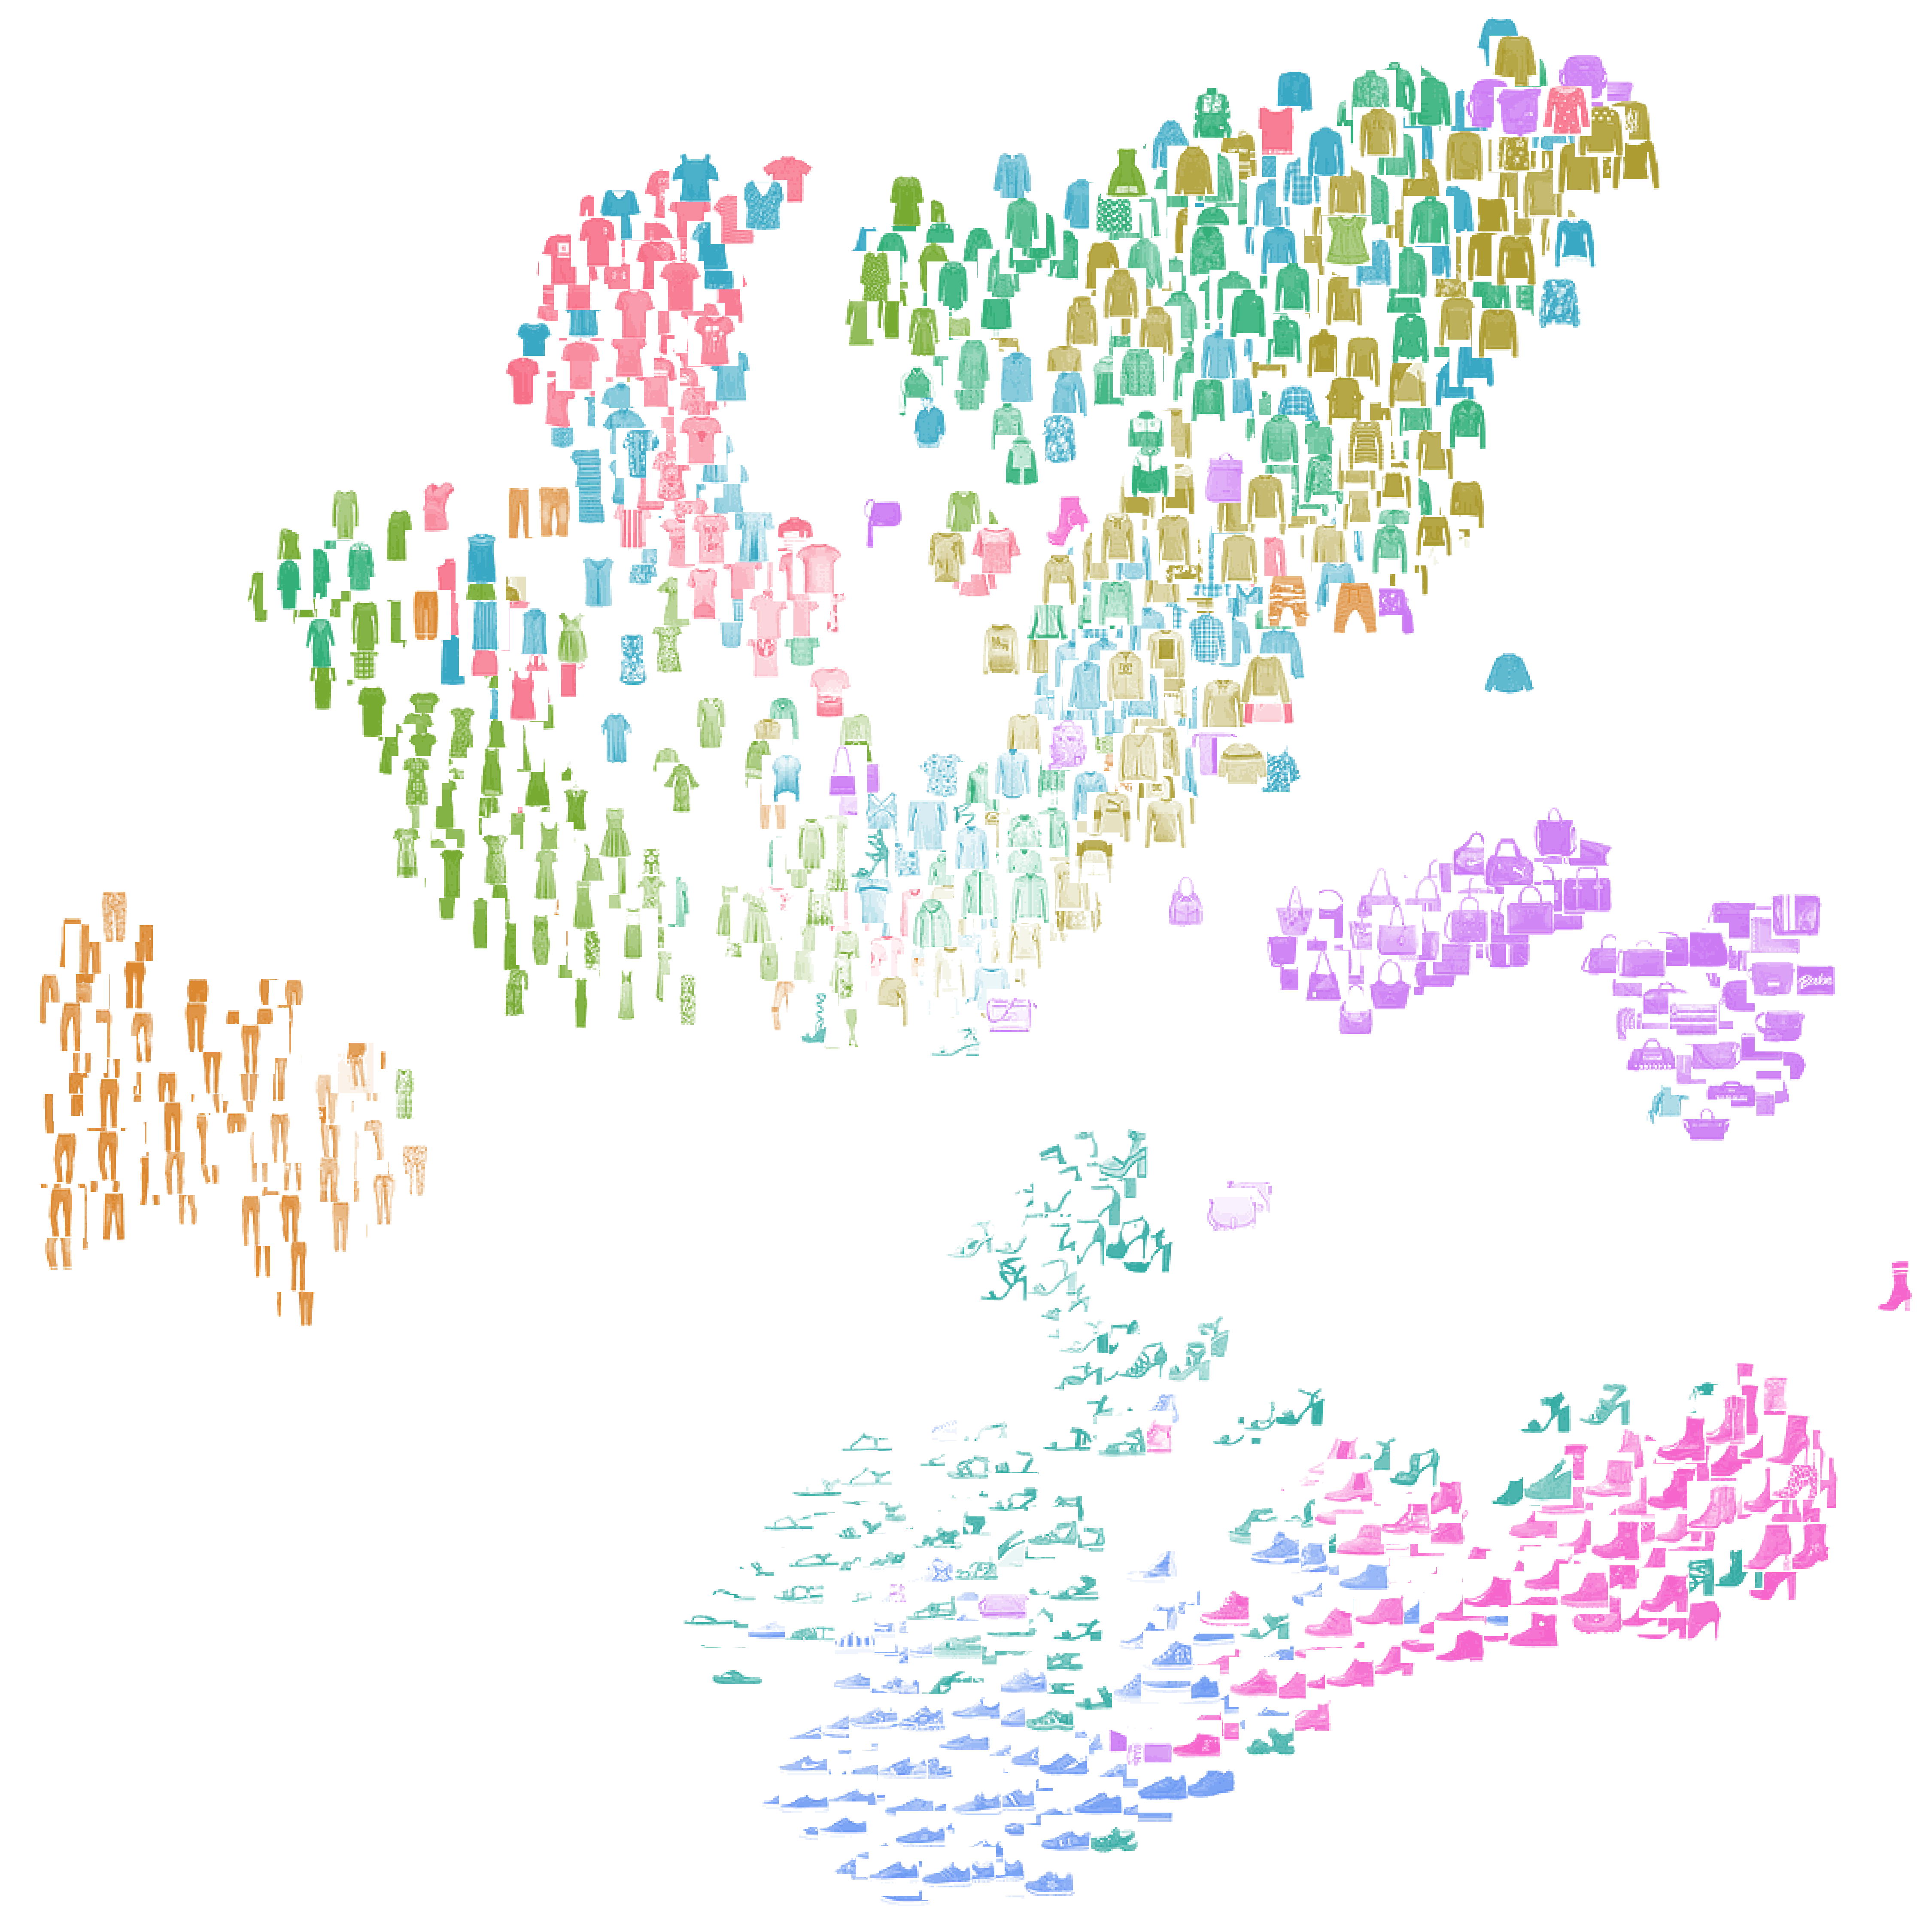
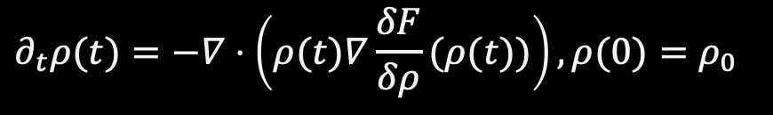




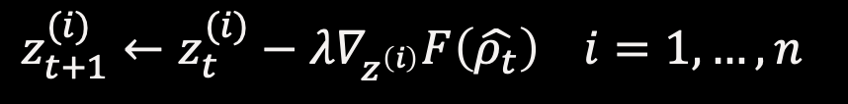
Gradient Flows in Probability Space
Need to solve optimization problem over (infinite dimensional, non-euclidean!) probability space
$$P(𝒳×𝒴)$$
$$F$$
Gradient flow in probability space:
[Ambrosio; Santambrogio; Figalli; Villani; etc]
$$∂_{t}ρ(t)=−∇⋅\left(ρ(t)∇\frac{δF}{δρ}(ρ(t))\right),ρ(0)=ρ_{0}$$
$$ρ_{0}$$
$$ρ^{∗}$$
finite particle approximation
time discretization
$$z_{t+1}^{(i)}←z_{t}^{(i)}−λ∇_{z^{\left(i\right)}}F\left(\hat{ρ_{t}}\right) i=1,…,n$$
22
each 'particle' is a data point (e.g., image)

Slide 23
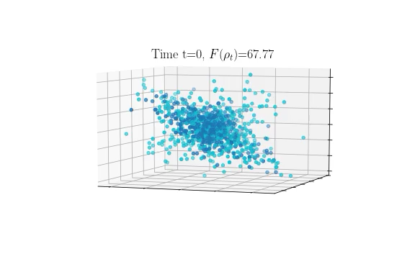
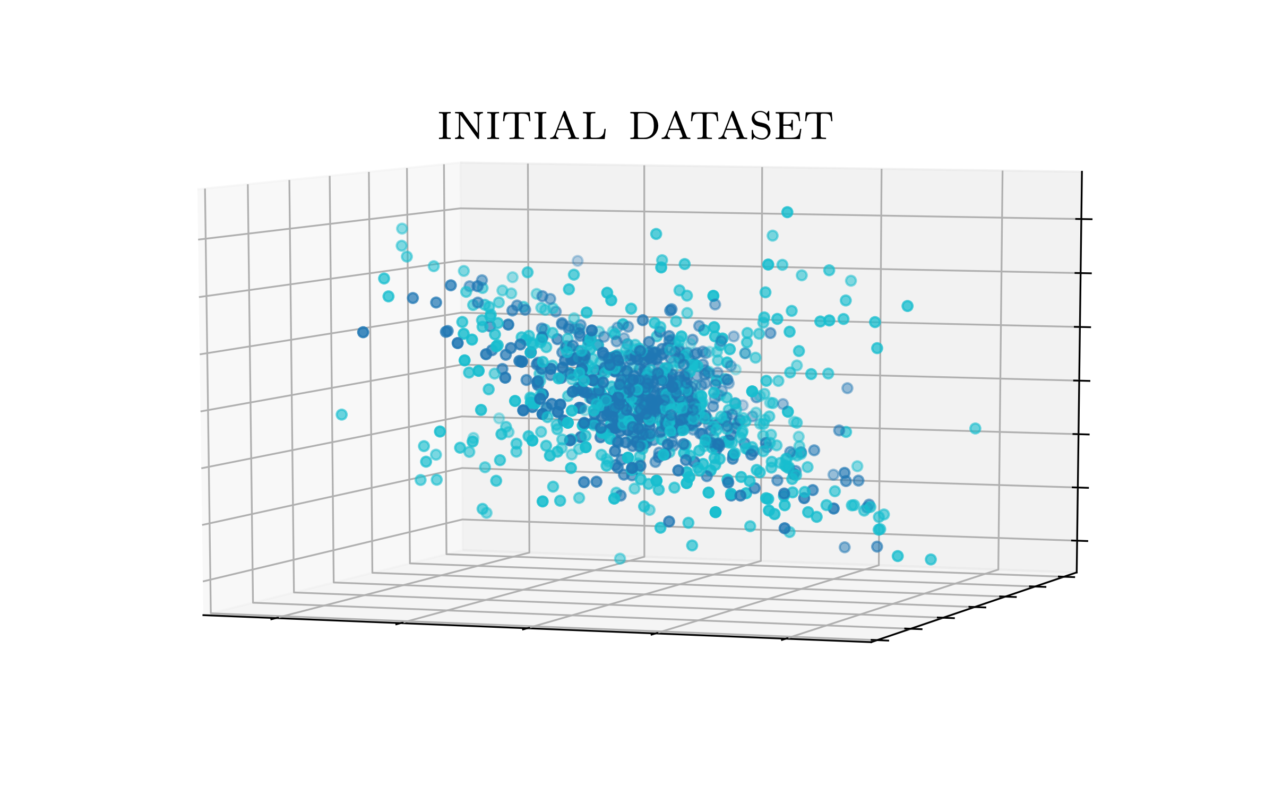

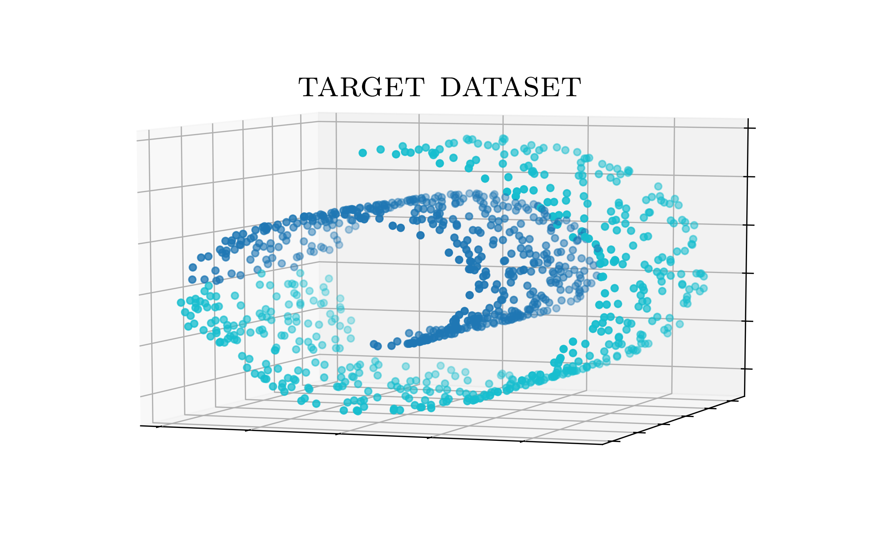
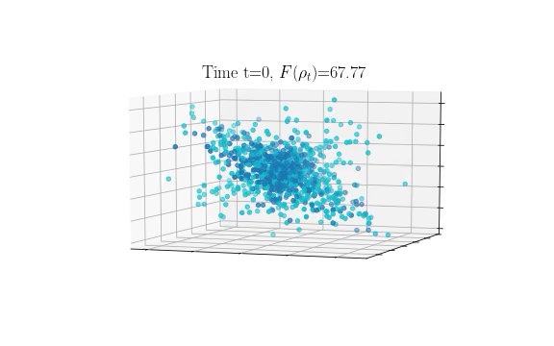







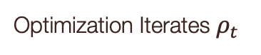
Application: Dataset Shaping
Optimization Iterates $ρ_{t}$
Functional Objective $F(ρ)$
Initial Dataset $ρ_{0}$
$$OTDD(ρ,ρ^{∗})$$
(distance only)
Want: similar to $ρ^{∗}$ but linearly separable
$$𝒱(ρ)$$
(constraint only)
Reference Dataset $ρ^{∗}$
$$OTDD(ρ,ρ^{∗})+𝒱(ρ)$$
(distance + constraint)

Slide 24

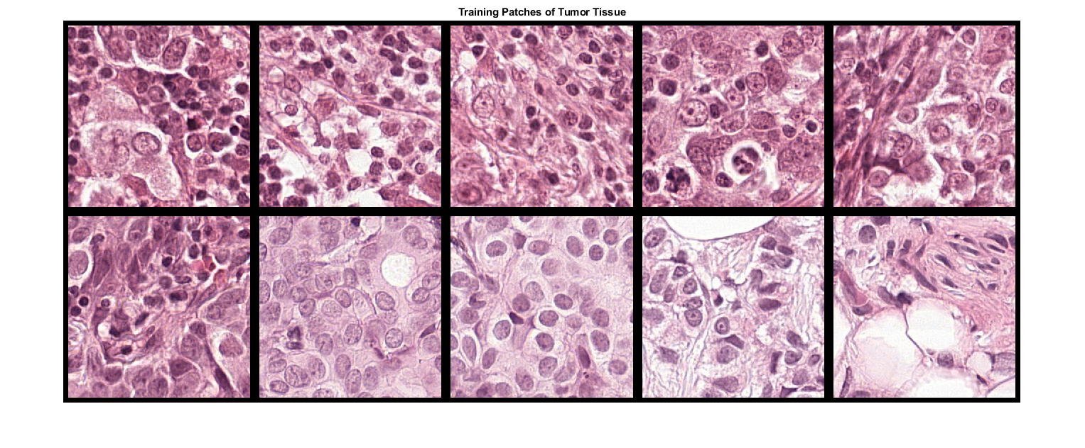
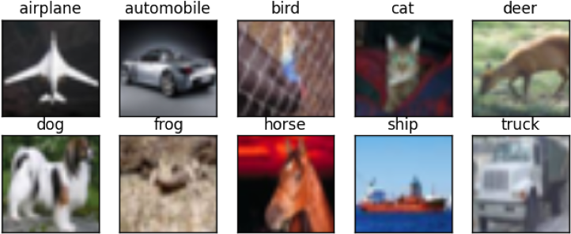
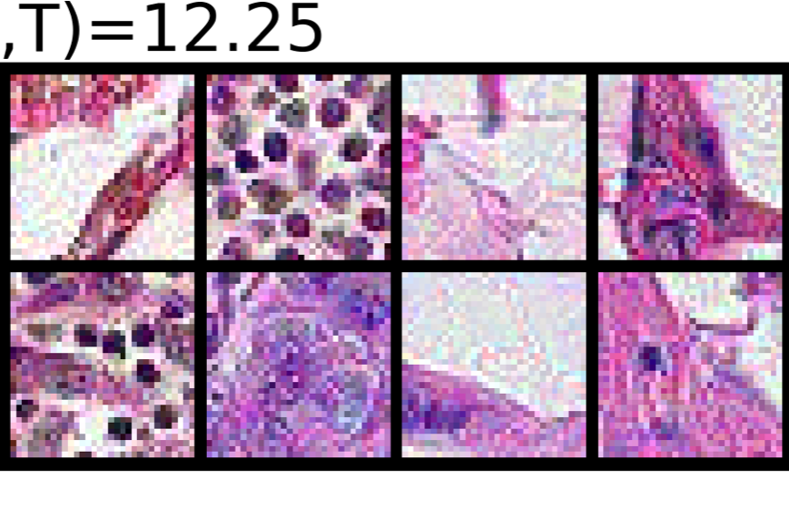
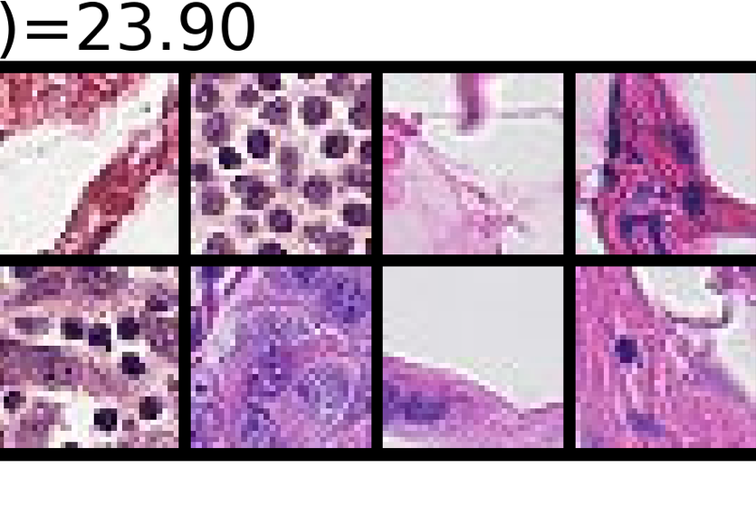
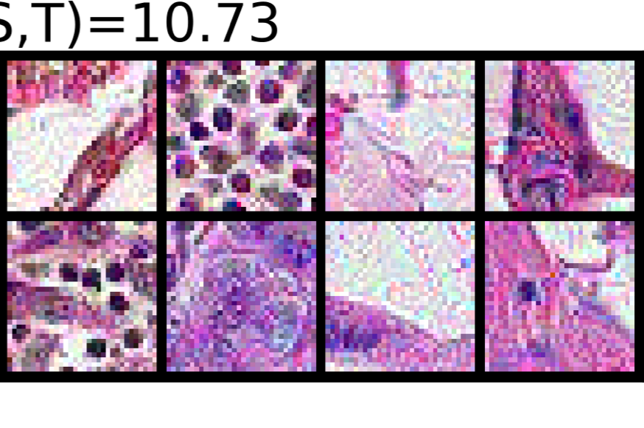
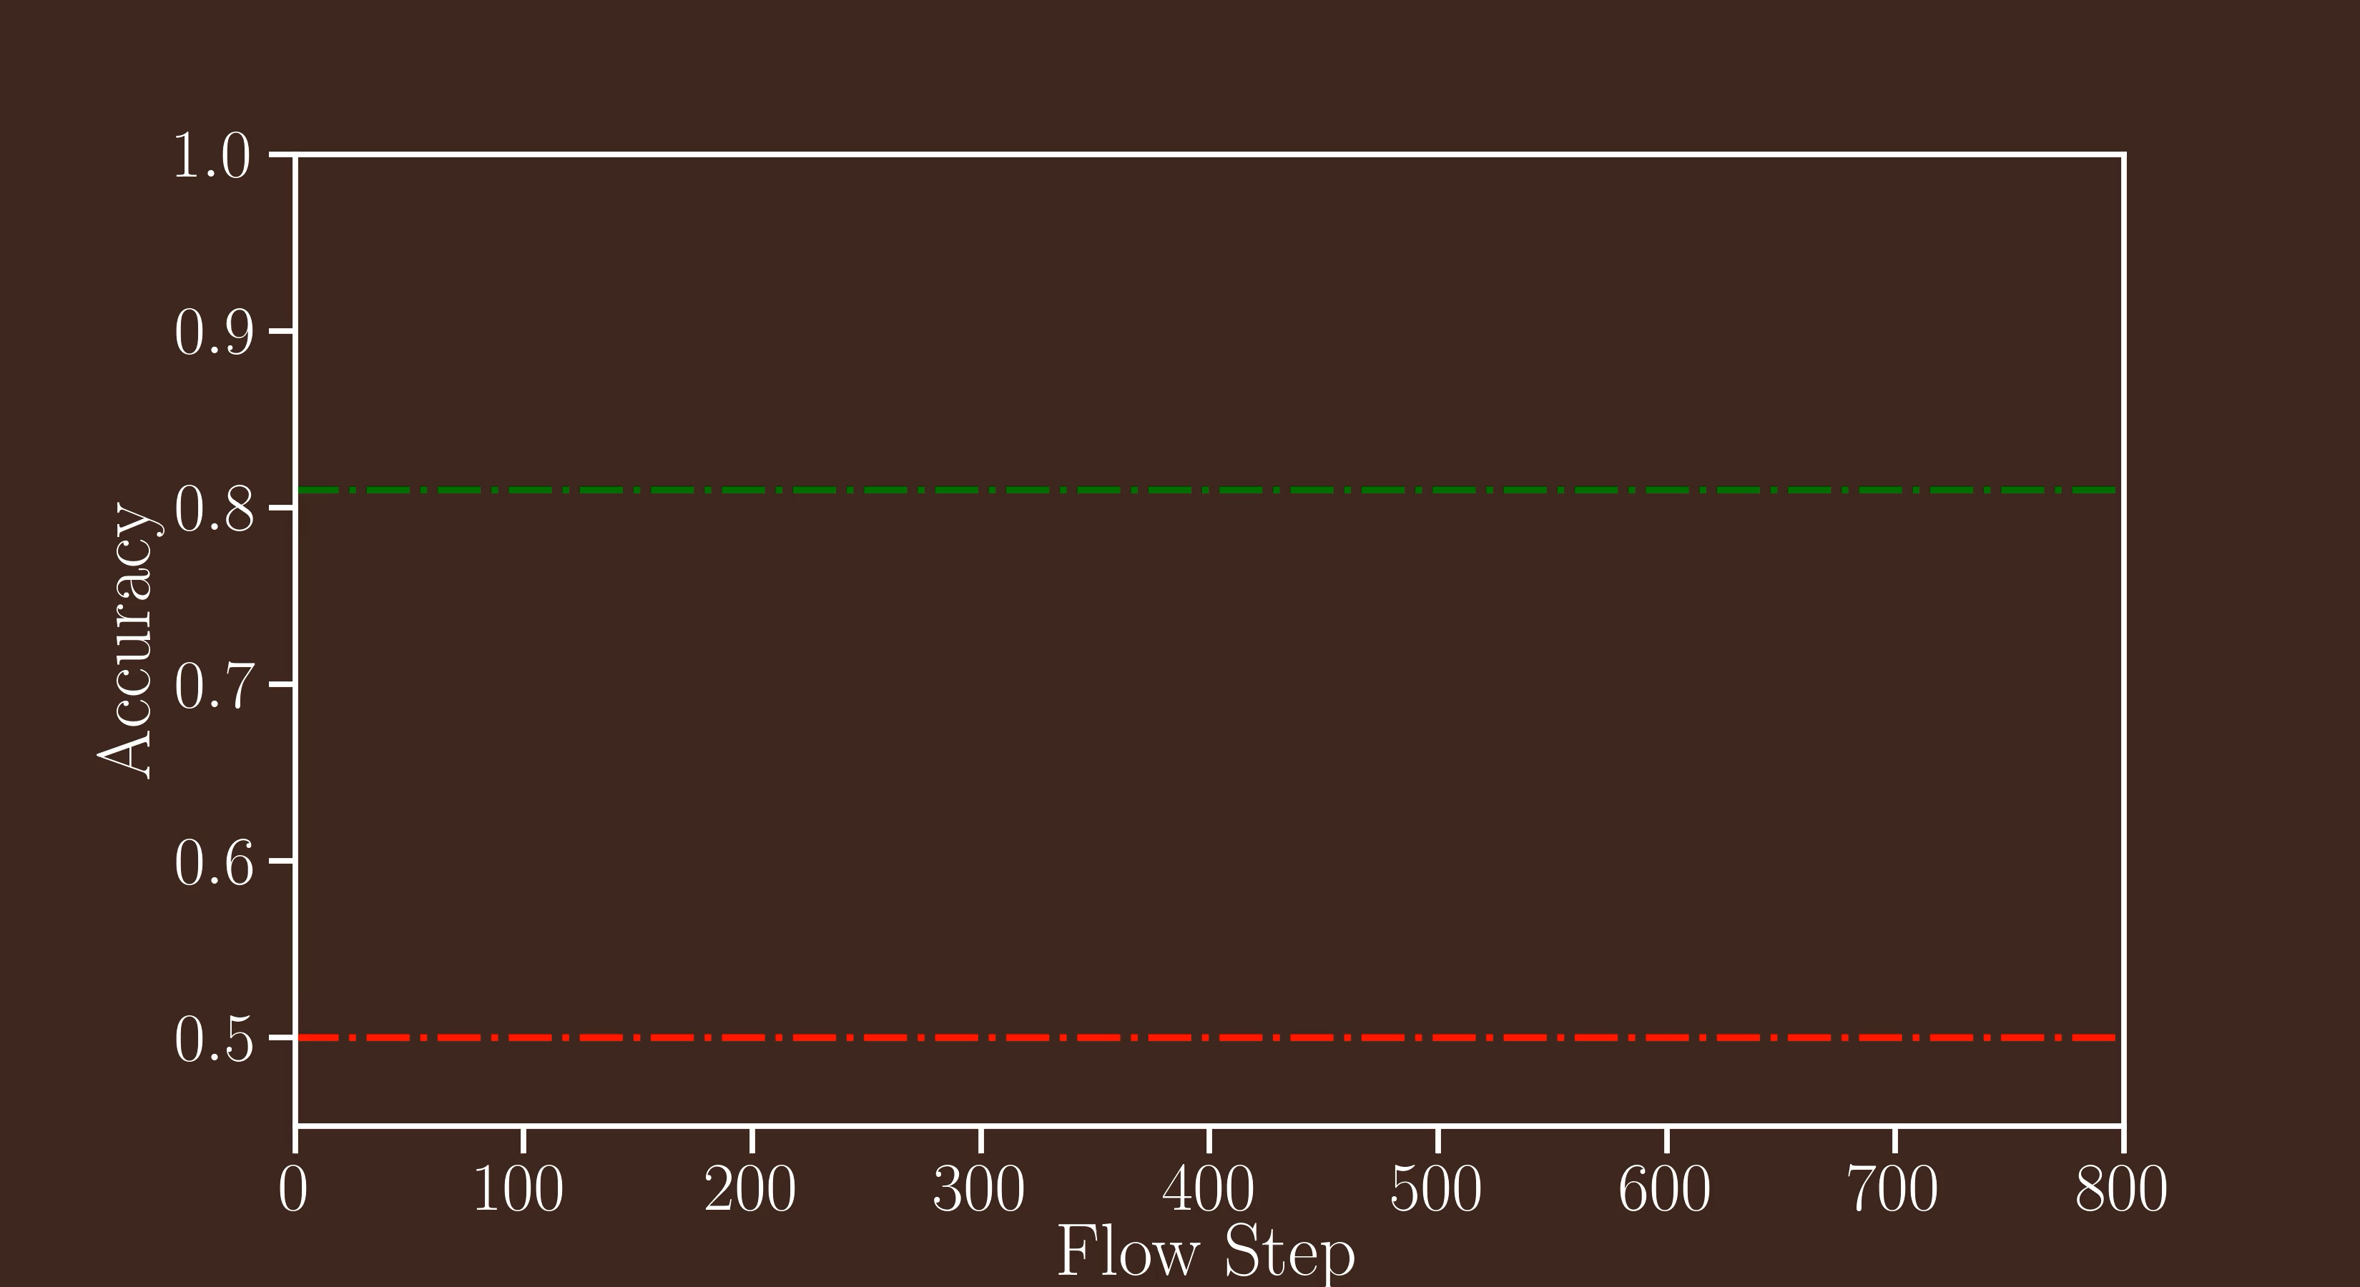
Flowing data to repurpose models
Predict
'Flow’ towards CIFAR10
Target Dataset: histopathology
Model: NN trained on CIFAR 10
(frozen after pre-training)
Key Takeaway:
models can be repurposed without modifying them!
model trained only on histopathology images
Frozen Model Accuracy
random guessing baseline
Flow Step
Notes:
To demonstrate this method, let's take a look a some real data
Our goal is to classify tumor/cancer cells on this medical imaging dataset.
But limited labeled data, not enough to train big model

Slide 25


Data Learning Tasks
$$\min{ℒ\left({ \atop }\right) }$$

Slide 26
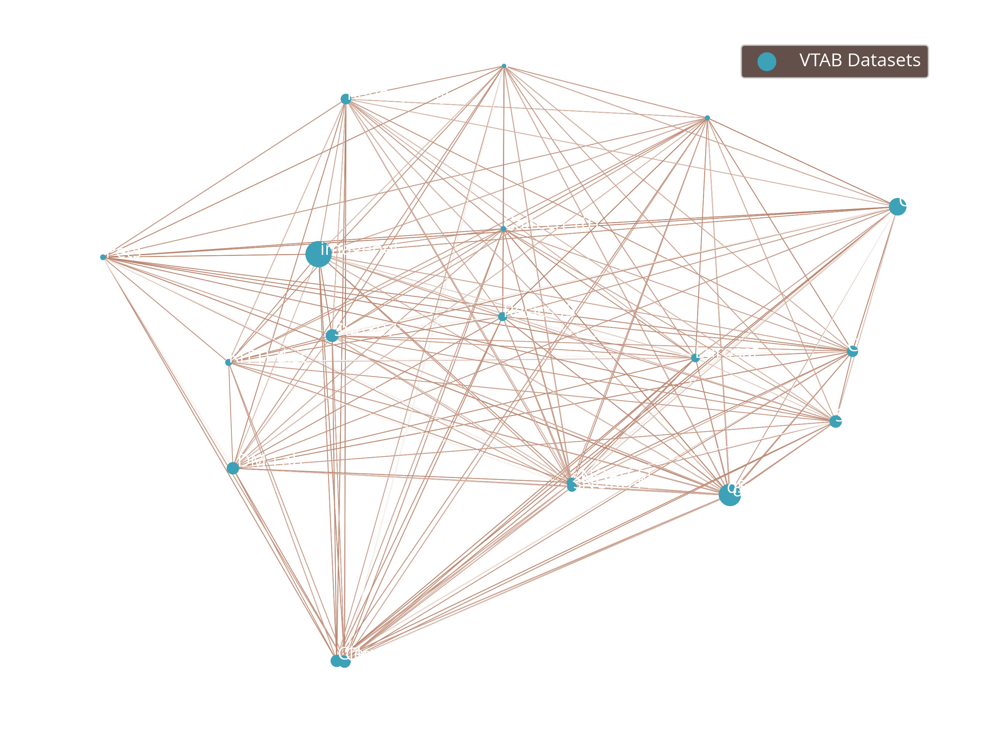
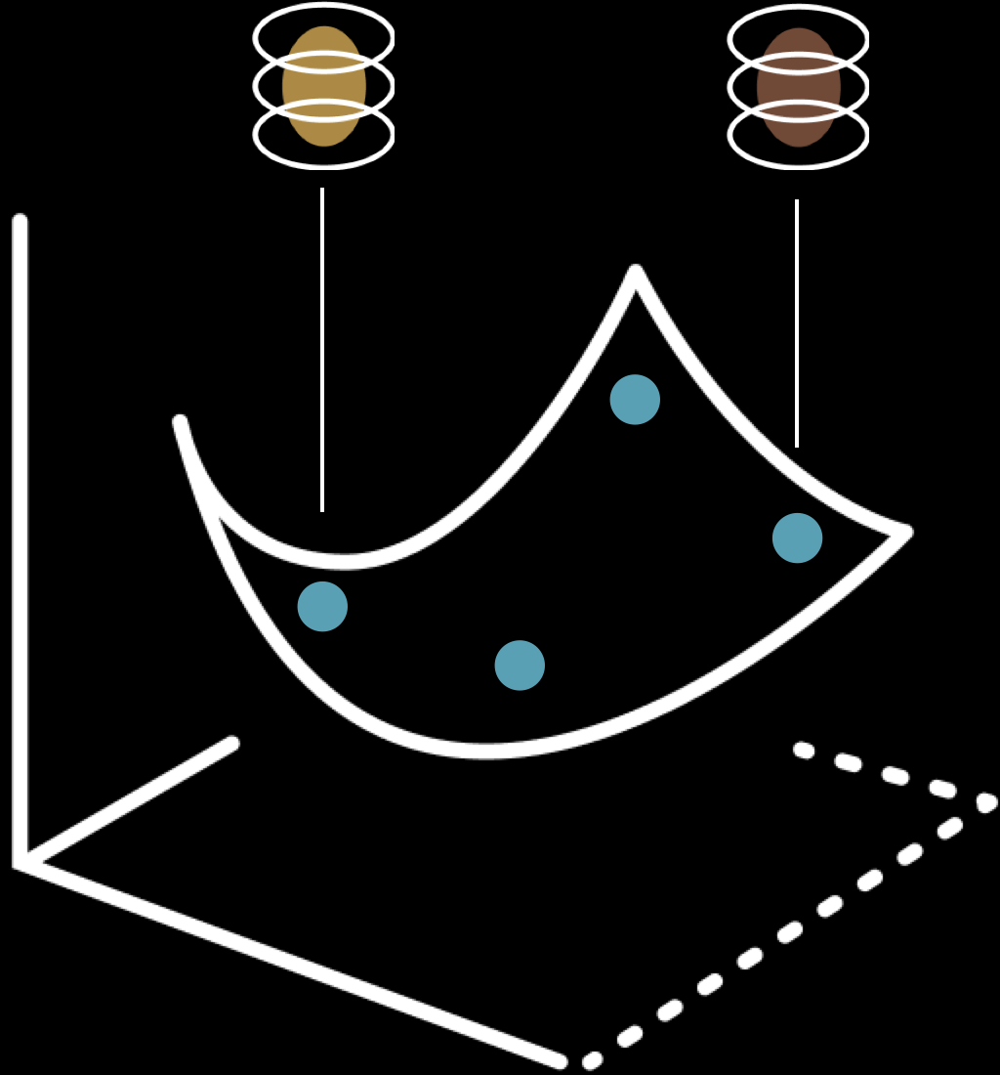
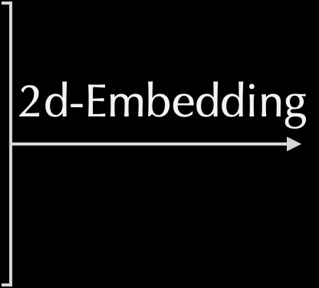

Generation in the Space of Datasets
Space of Datasets
(general-purpose data)
Can we ’fill gaps’ in this manifold to generalize better?
or ’project’ into manifold to create closest training dataset?

Slide 27
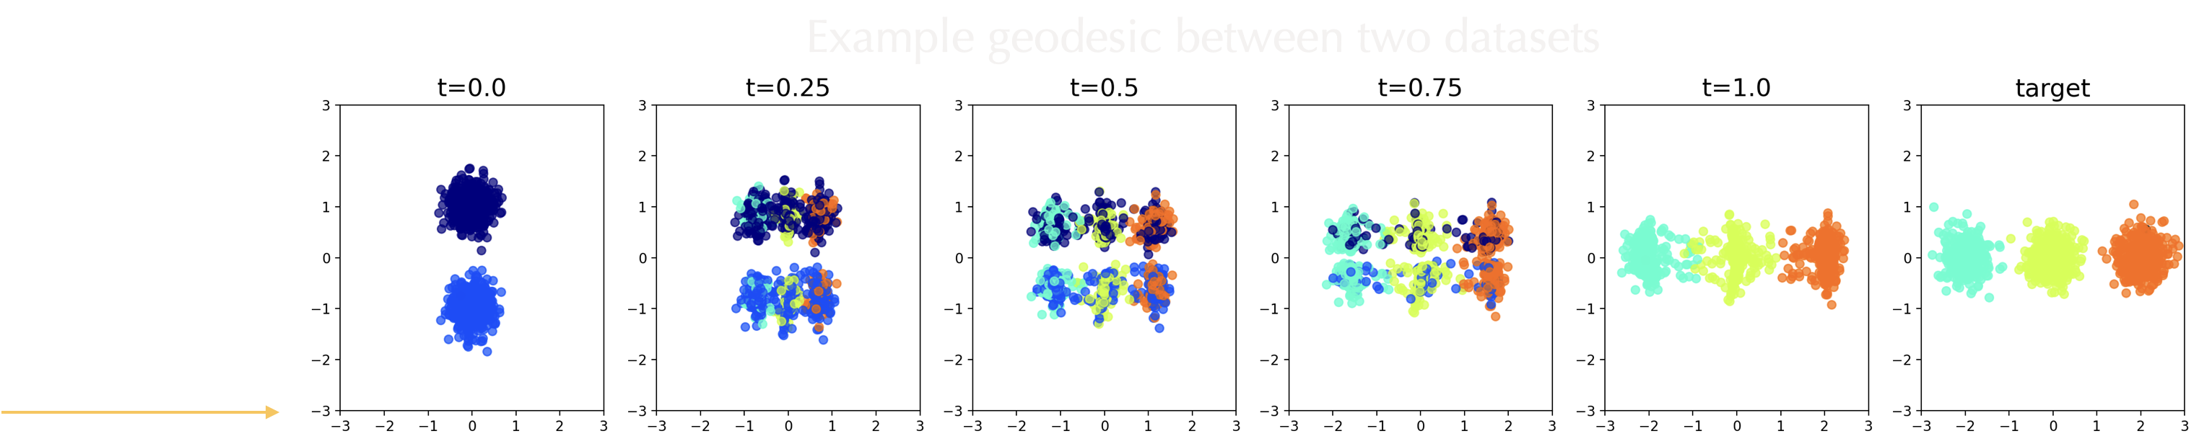
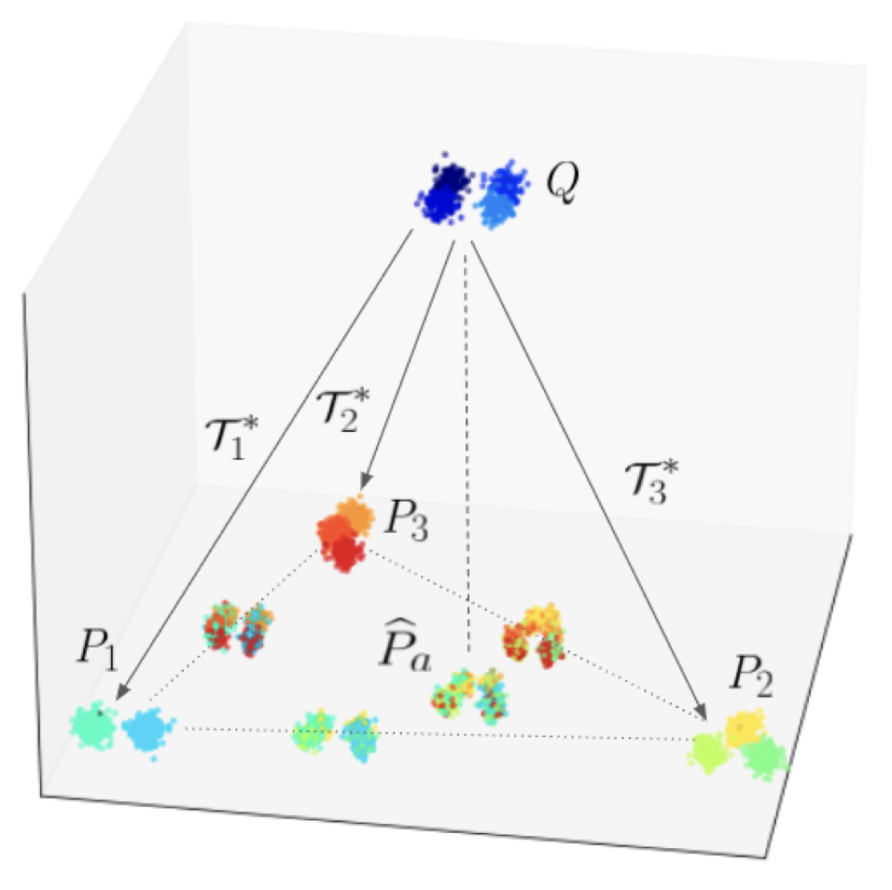
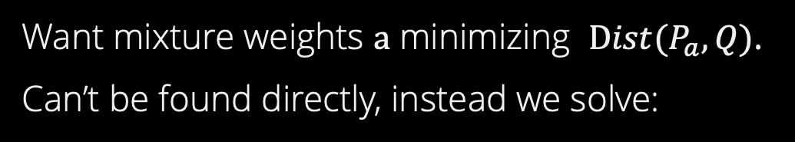
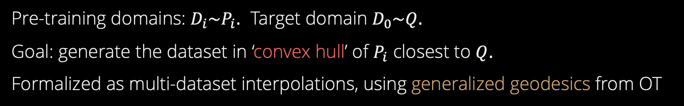
Adaptation by Synthesis
Pre-training domains: $D_{i}\sim P_{i}$. Target domain $D_{0}\sim Q$.
Goal: generate the dataset in ‘convex hull’ of $P_{i}$ closest to $Q$.
Formalized as multi-dataset interpolations, using generalized geodesics from OT
Want mixture weights $a$ minimizing $\text{D}ist(P_{a}, Q)$.
Can’t be found directly, instead we solve:
[A-M & Fan, UAI 2023]

Slide 28
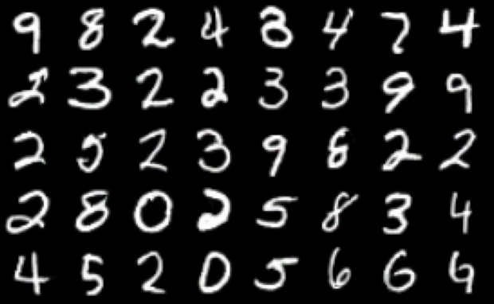
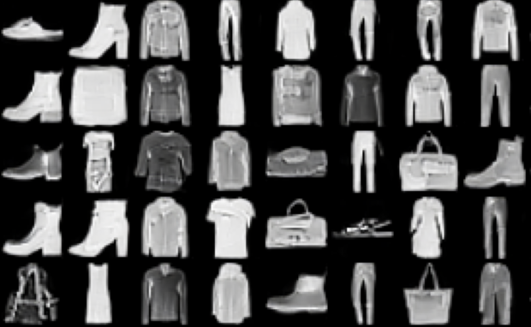
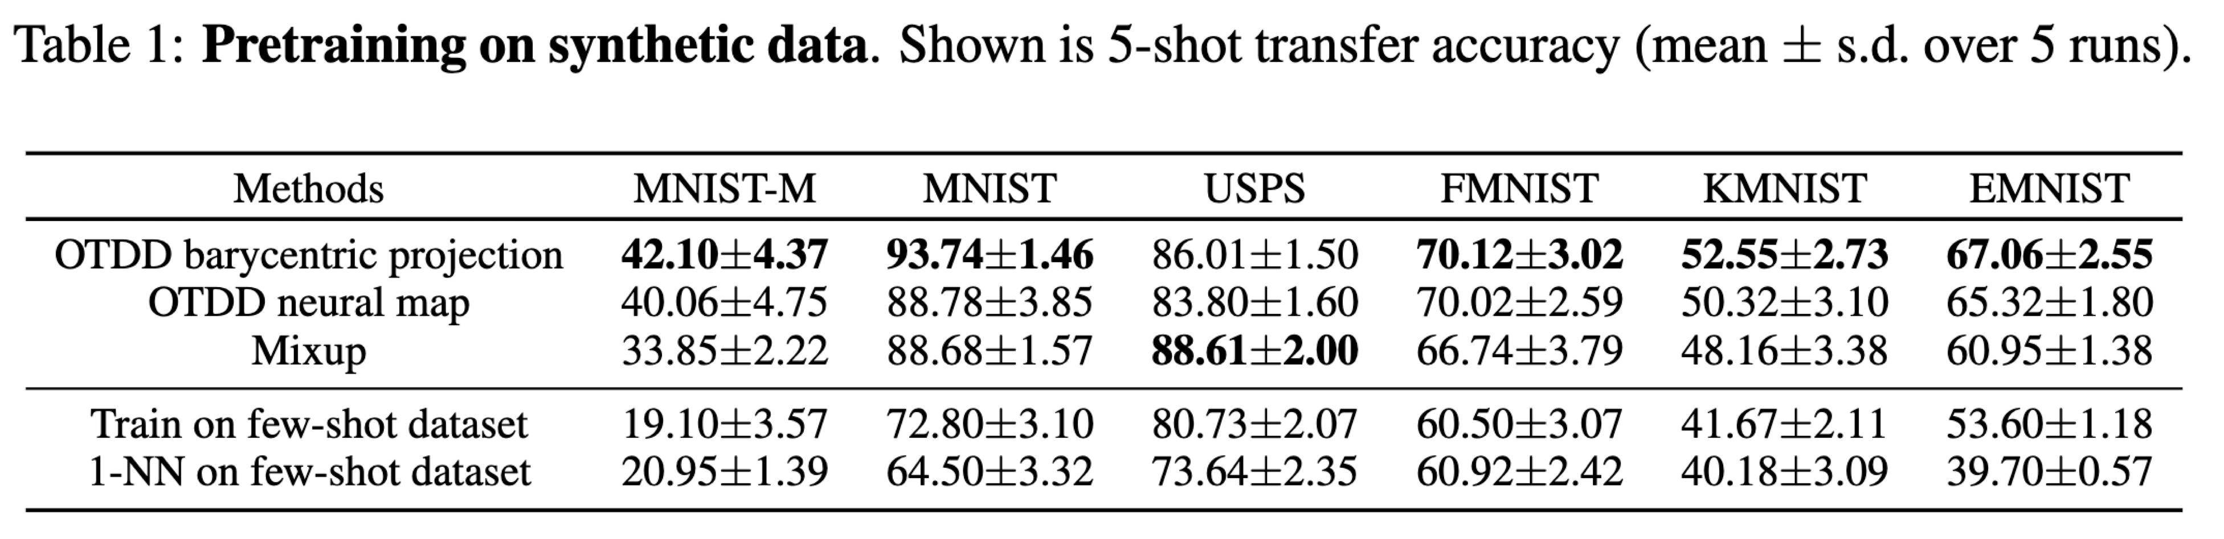
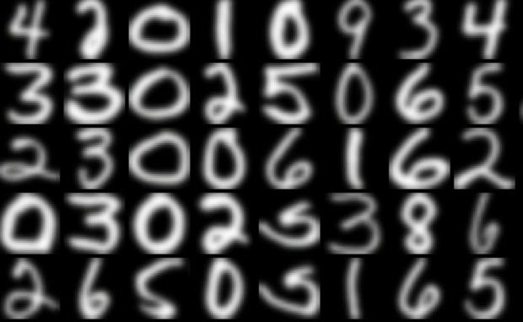
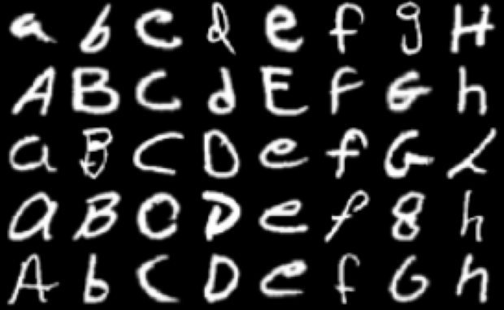
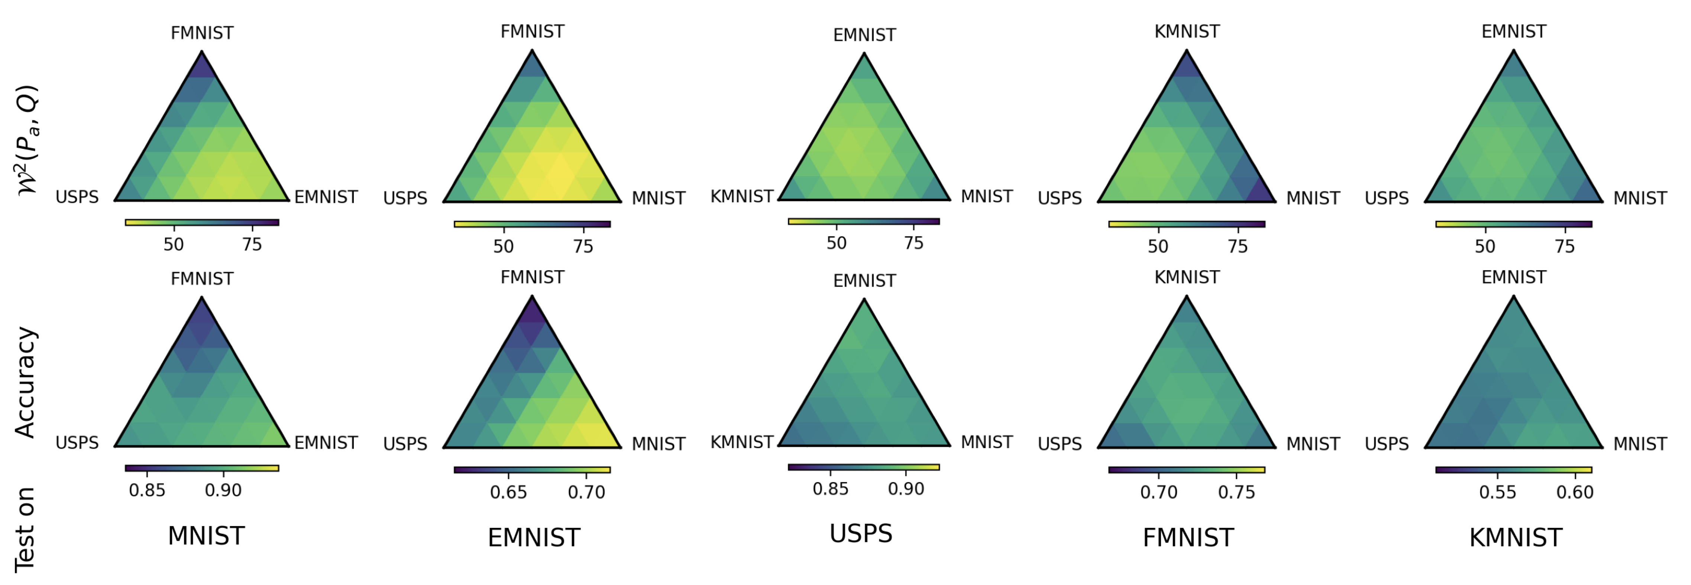
Adaptation by Synthesis
Pre-training on synth dataset closest to target + adapting:
MNIST
F-MNIST
?
USPS
EMNIST
larger scale results (e.g. ImageNet$⟺$VTAB) on paper
Dataset Distance
(between synth and target datasets)
each region is a synthetic dataset we generate
Transfer Accuracy
(pretrain on synth, adapt to target)

Slide 29
‘Usual’ Adaptation:
Take-Home
Messages
Focuses exclusively on model
Data-Centric Way:
Data informs (or replaces!) model adaptation
Predict when and where to adapt using data
Adapt the model implicitly by ‘flowing’ data
Synthesize new datasets optimized for adaptation
Notes:
Best way to explain this new paradigm is by contrasting it with the current satuts-quo of AI
in which datasets are assumed to be fixed. Model is trained, and if new dataset arrives, model’s params adapted to take into account this new dat
In contrast, in the Data-Centric AI paradigm, models are now fixed and learning focuses on the datasets, which are adapted to suit the model

Slide 30
How we will get there:
Zen and Hard Work
Notes:
30
finale

Slide 31

Zen
Make appropriate model choices
Understand the principles such that you can use new techniques
Identify sources of error, in the maths and in the sociotechnical context
Evaluate carefully
Notes:
31
finale

Slide 32
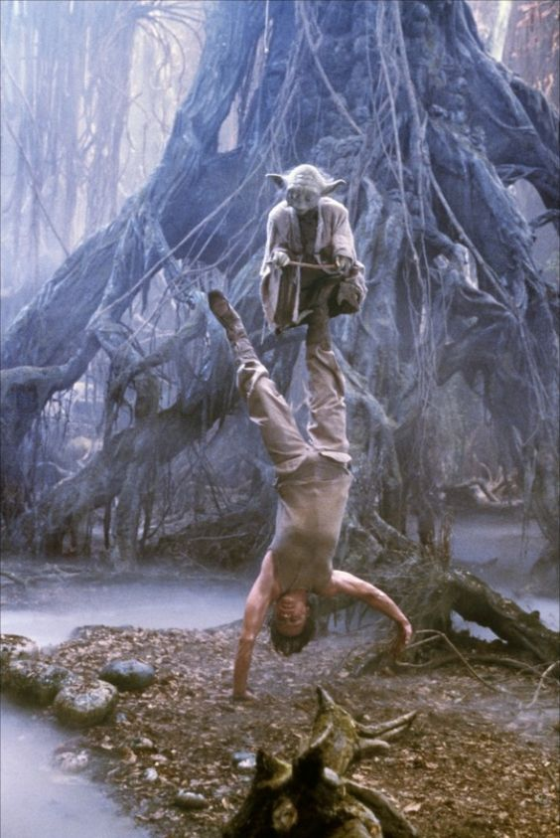
Zen
Make appropriate model choices
Understand the principles such that you can use new techniques
Identify sources of error, in the maths and in the sociotechnical context
Evaluate carefully
Notes:
32
finale

Slide 33
How we will get there:
ML Taxonomy,
Course Structure
Notes:
33
david

Slide 34
High-Level Setup
Task
Metric
Data
Some output: a prediction, summary, or recommendation
New
input
Professional ethics requires that you get that box right.
Notes:
34
david

Slide 35
High-Level Setup
Stakeholder(s) needs and goals
Data collection process, data pre-processing
Task
Metric
Data
Data
Request
Process
Some output: a prediction, summary, or recommendation
Use of output
to meet
goals
New
input
Societal ethics demands that you do not ignore the larger picture.
Notes:
35
david

Slide 36
Structure of the Course
Follow the “cube”++
Supervised: regression, classification
Unsupervised: clustering, embeddings
Graphical Models, Reinforcement Learning
Excursions to discuss model classes, model selection, evaluation...
Probabilistic
Non-Probabilistic
Continuous
Discrete
Supervised
Unsupervised
+ graphical models, reinforcement learning
Notes:
36
david

Slide 37
Structure of the Course
Follow the “cube”++
Supervised: regression, classification
Unsupervised: clustering, embeddings
Graphical Models, Reinforcement Learning
Excursions to discuss model classes, model selection, evaluation...
Probabilistic
Non-Probabilistic
Continuous
Discrete
Supervised
Unsupervised
+ graphical models, reinforcement learning
Notes:
37
david

Slide 38


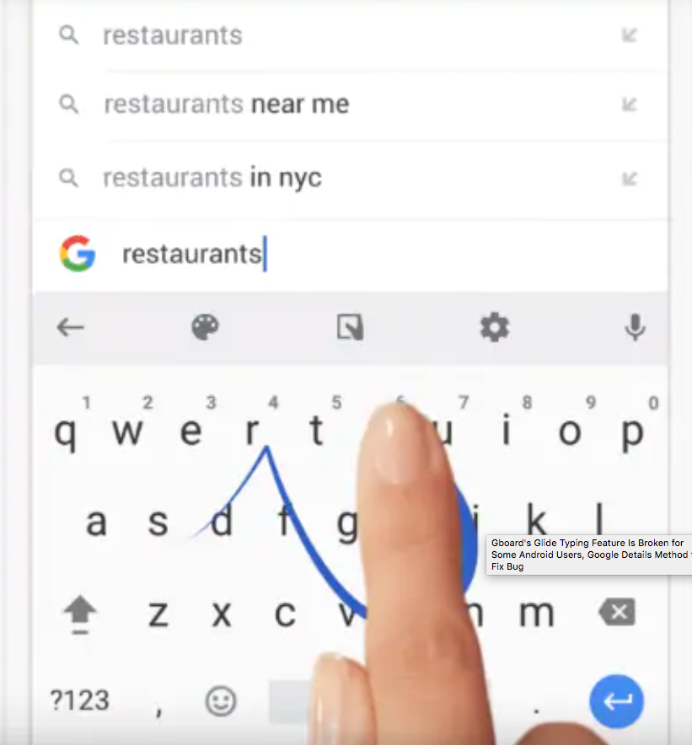
Example: “Swipe typing”
Supervised: Output is a Prediction
Discrete:
Output is a
Word
Probabilistic:
Works by building a language model
Android Glide Typing
iOS QuickPath
https://www.macworld.com/article/3432168/how-to-use-the-quickpath-swipe-keyboard.html https://en.wikipedia.org/wiki/Swype https://gadgets.ndtv.com/apps/news/gboard-for-android-glide-typing-bug-fix-google-1917639
Notes:
38
david
https://www.macworld.com/article/3432168/how-to-use-the-quickpath-swipe-keyboard.html

Slide 39
Structure of the Course
Follow the “cube”++
Supervised: regression, classification
Unsupervised: clustering, embeddings
Graphical Models, Reinforcement Learning
Excursions to discuss model classes, model selection, evaluation...
Probabilistic
Non-Probabilistic
Continuous
Discrete
Supervised
Unsupervised
+ graphical models, reinforcement learning
Notes:
39
david

Slide 40
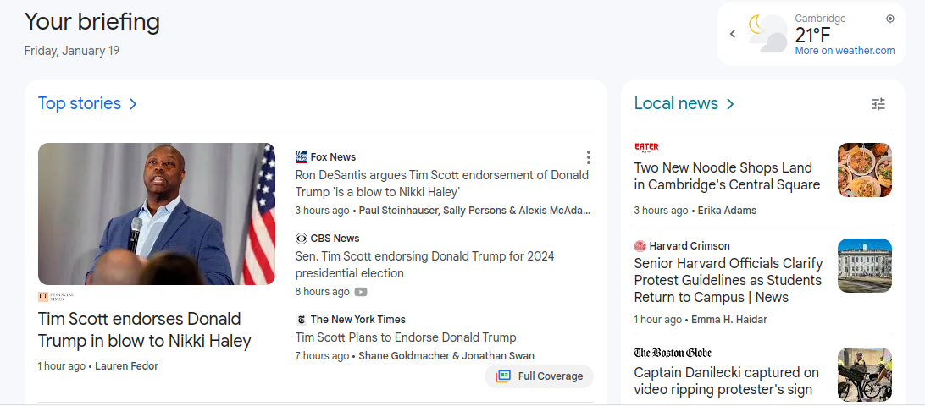
Example: Google News
Unsupervised: Output is a Summary
Discrete:
Outputs are
Clusttered
Notes:
40
david

Slide 41
Structure of the Course
Follow the “cube”++
Supervised: regression, classification
Unsupervised: clustering, embeddings
Graphical Models, Reinforcement Learning
Excursions to discuss model classes, model selection, evaluation...
Probabilistic
Non-Probabilistic
Continuous
Discrete
Supervised
Unsupervised
+ graphical models, reinforcement learning
Notes:
41
david

Slide 42
Example: Google News
RL: Output is a Recommendation
Notes:
42
david

Slide 43
Lecture Structure
Story/real-life example
Lecture content, quiet questions option
Concept checks
Lectures will include real world examples and concept
exercises; we’ll also discuss ethics
Notes:
43
david

Slide 44
Logistics
HW0 due Friday: this is a check on your prereqs.
In person. Let’s help keep each other safe by masking if ill/exposed.
Lecture recaps, CS181 “textbook” as resources (including if ill). You are responsible for finding ways to keep up with your learning!
Regular homeworks: biweekly (8p Friday), done individually, combining theoretical, programming, and broader thinking elements (LaTex, Python)
Six late days, at most two per problem set
Two timed, closed-book midterms
Sections: section zero: math+code this week, then weekly sections on content
Lots of office hours (in person and on zoom)
Ed: for all discussion and questions on course content (content, clarification, private message)
Yes, you may sit in, audit, etc.!
Notes:
44
david

Slide 45
Logistics
HW0 due Friday: this is a check on your prereqs.
In person. Let’s help keep each other safe by masking if ill/exposed.
Lecture recaps, CS181 “textbook” as resources (including if ill). You are responsible for finding ways to keep up with your learning!
Regular homeworks: biweekly (8p Friday), done individually, combining theoretical, programming, and broader thinking elements (LaTex, Python)
Six late days, at most two per problem set
Two timed, closed-book midterms
Sections: section zero: math+code this week, then weekly sections on content
Lots of office hours (in person and on zoom)
Ed: for all discussion and questions on course content (content, clarification, private message)
Yes, you may sit in, audit, etc.!
We’re in difficult times.
Let’s make a collective commitment to be
human to each other.
Notes:
45
david

Slide 46
Collaboration Policy
You may work with others, but your write-up must be entirely written by yourself in your own words. You may help each other debug code, but again, the code must be written by you.
Think of GenAI as a collaborator: cite if/how you use tools.
Include the names of anyone you worked with in your write-up.
Do not copy parts of another person's assignment or jointly type up an assignment.
You can make use of textbooks and online sources to help in answering questions, but you must cite your sources (and you should be ready to explain your answer to a member of the teaching staff)
Do not look up solutions to specific questions from the internet or other sources (e.g. friends from previous years)
Notes:
46
david

Slide 47
A Short Break
(and then, … nonparametric regression)
Notes:
47
Finale

